Slide 1
Introduction to Cybersecurity
Department of
York College of Pennsylvania

Slide 2
Chapter 1: roadmap
1.1 Fundamental Concepts
1.2 Access Control Models
1.3 Cryptographic Concepts
1.4 Implementation and Usability Issues

Slide 3
Defining Security
The security of a system, application, or protocol is always relative to
– A set of desired properties – An adversary with specific capabilities
For example, standard file access permissions in Linux and Windows are not effective against an adversary who can boot from a CD

Slide 4
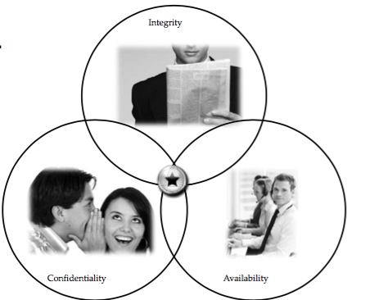
Security Goals

Slide 5
Confidentiality
Confidentiality is the avoidance of the unauthorized disclosure of information.
confidentiality involves the protection of data, providing access for those who are allowed to see it while disallowing others from learning anything about its content.

Slide 6
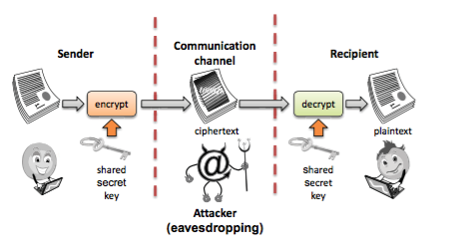
Tools for Confidentiality
Encryption: the transformation of information using a secret, called an encryption key, so that the transformed information can only be read using another secret, called the decryption key (which may, in some cases, be the same as the encryption key).

Slide 7
Tools for Confidentiality
Access control: rules and policies that limit access to confidential information to those people and/or systems with a “need to know.”
– This need to know may be determined by identity, such as a person’s name or a computer’s serial number, or by a role that a person has, such as being a manager or a computer security specialist.

Slide 8
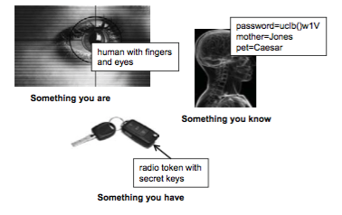
Tools for Confidentiality
Authentication: the determination of the identity or role that someone has. This determination can be done in a number of different ways, but it is usually based on a combination of
– something the person has (like a smartcard or a radio key fob storing secret keys),
– something the person knows (like a password), – something the person is (like a human with a fingerprint).

Slide 9
Tools for Confidentiality
Authorization: the determination if a person or system is allowed access to resources, based on an access control policy.
– Such authorizations should prevent an attacker from tricking the system into letting him have access to protected resources.
Physical security: the establishment of physical barriers to limit access to protected computational resources.
– Such barriers include locks on cabinets and doors, the placement of computers in windowless rooms, the use of sound dampening materials, and even the construction of buildings or rooms with walls incorporating copper meshes (called Faraday cages) so that electromagnetic signals cannot enter or exit the enclosure.

Slide 10
Integrity
Integrity: the property that information has not be altered in an unauthorized way.
Tools:
– Backups: the periodic archiving of data.
– Checksums: the computation of a function that maps the contents of a file to a numerical value. A checksum function depends on the entire contents of a file and is designed in a way that even a small change to the input file (such as flipping a single bit) is highly likely to result in a different output value.
– Data correcting codes: methods for storing data in such a way that small changes can be easily detected and automatically corrected.

Slide 11
Availability
Availability: the property that information is accessible and modifiable in a timely fashion by those authorized to do so.
Tools:
– Physical protections: infrastructure meant to keep information available even in the event of physical challenges.
– Computational redundancies: computers and storage devices that serve as fallbacks in the case of failures.

Slide 12
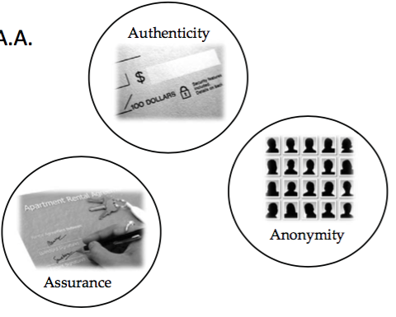
Other Security Concepts

Slide 13
Assurance
Assurance refers to how trust is provided and managed in computer systems.
Trust management depends on:
– Policies, which specify behavioral expectations that people or systems have for themselves and others.
For example, the designers of an online music system may specify policies that describe how users can access and copy songs.
– Permissions, which describe the behaviors that are allowed by the agents that interact with a person or system.
For instance, an online music store may provide permissions for limited access and copying to people who have purchased certain songs.
– Protections, which describe mechanisms put in place to enforce permissions and polices.
We could imagine that an online music store would build in protections to prevent people from unauthorized access and copying of its songs.

Slide 14

Authenticity
• Authenticity is the ability to determine that statements, policies, and permissions issued by persons or systems are genuine.
• Primary tool:
– digital signatures. These are cryptographic computations that allow a person or system to commit to the authenticity of their documents in a unique way that achieves nonrepudiation, which is the property that authentic statements issued by some person or system cannot be denied.

Slide 15
Anonymity
Anonymity: the property that certain records or transactions not to be attributable to any individual.
Tools:
– Aggregation: the combining of data from many individuals so that disclosed sums or averages cannot be tied to any individual.
– Mixing: the intertwining of transactions, information, or communications in a way that cannot be traced to any individual.
– Proxies: trusted agents that are willing to engage in actions for an individual in a way that cannot be traced back to that person.
– Pseudonyms: fictional identities that can fill in for real identities in communications and transactions, but are otherwise known only to a trusted entity.

Slide 16
Types of Threats
Notes:
This diagram shows threats categorized according to whether they are human-caused, malicious, or directed. These characteristics will affect security planning in important ways later.

Slide 17
Advanced Persistent Threat (APT)
Organized
Directed
Well financed
Patient
Silent
Notes:
APT is a special type of threat that has only been taken seriously by the broad security community over the past decade. In general, security experts believe that no one who becomes a high-priority target can truly be safe from APT.

Slide 18
Types of Attackers
Notes:
Each of these attacker types is associated with a different set of resources, capabilities, and motivations. Understanding the different types will help later in considering threats.

Slide 19
Types of Harm
Notes:
These are the primary types of harm against system data and functions. Understanding these possibilities is important to considering threat and risk.

Slide 20
Method—Opportunity--Motive
Notes:
Understanding method, motive, and opportunity can be a good way to think about potential threats. Reducing any of those dimensions can lower the risk to the system.

Slide 21
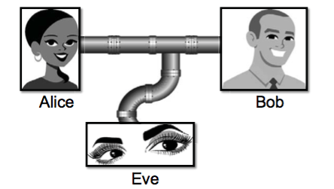
Threats and Attacks
• Eavesdropping: the interception of information intended for someone else during its transmission over a communication channel.

Slide 22
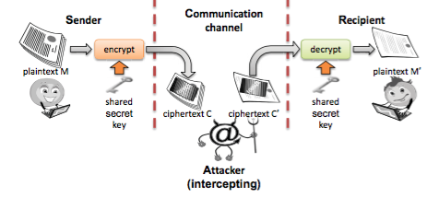
Threats and Attacks
• Alteration: unauthorized modification of information.
Eve
15
– Example: the man-in-the-middle attack, where a network stream is intercepted, modified, and retransmitted.

Slide 23
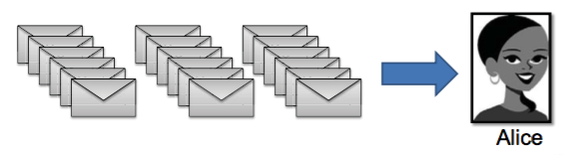
Threats and Attacks
• Denial-of-service: the interruption or degradation of a data service or information access.
– Example: email spam, to the degree that it is meant to simply fill up a mail queue and slow down an email server.

Slide 24
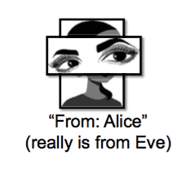
Threats and Attacks
• Masquerading: the fabrication of information that is purported to be from someone who is not actually the author.

Slide 25
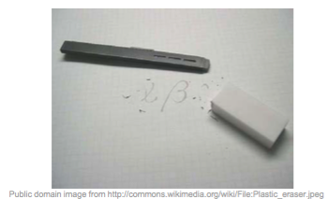
Threats and Attacks
• Repudiation: the denial of a commitment or data receipt.
– This involves an attempt to back out of a contract or a protocol that requires the different parties to provide receipts acknowledging that data has been received.

Slide 26
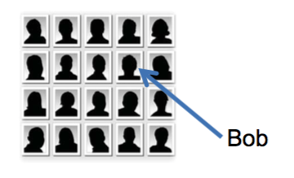
Threats and Attacks
• Correlation and traceback: the integration of multiple data sources and information flows to determine the source of a particular data stream or piece of information.

Slide 27
Controls/Countermeasures
Notes:
This representation shows the three dimensions by which a control can be categorized. Thinking about controls in this way enables you to easily map the controls against the threats they help address.

Slide 28
Different Types of Controls
Notes:
In this simple representation of a networked system, it is easy to see all the touch points where controls can be placed, as well as some different types of controls, including deterrence, deflection, response, prevention, and preemption.

Slide 29
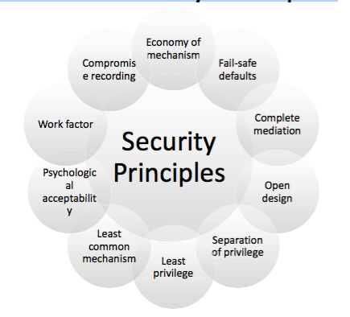
The Ten Security Principles

Slide 30
Economy of mechanism
This principle stresses simplicity in the design and implementation of security measures.
– While applicable to most engineering endeavors, the notion of simplicity is especially important in the security domain, since a simple security framework facilitates its understanding by developers and users and enables the efficient development and verification of enforcement methods for it.

Slide 31
Fail-safe defaults
This principle states that the default configuration of a system should have a conservative protection scheme.
– For example, when adding a new user to an operating system, the default group of the user should have minimal access rights to files and services. Unfortunately, operating systems and applications often have default options that favor usability over security.
– This has been historically the case for a number of popular applications, such as web browsers that allow the execution of code downloaded from the web server.

Slide 32
Complete mediation
The idea behind this principle is that every access to a resource must be checked for compliance with a protection scheme.
– As a consequence, one should be wary of performance improvement techniques that save the results of previous authorization checks, since permissions can change over time.
– For example, an online banking web site should require users to sign on again after a certain amount of time, say, 15 minutes, has elapsed.

Slide 33
Open design
According to this principle, the security architecture and design of a system should be made publicly available.
– Security should rely only on keeping cryptographic keys secret.
– Open design allows for a system to be scrutinized by multiple parties, which leads to the early discovery and correction of security vulnerabilities caused by design errors.
– The open design principle is the opposite of the approach known as security by obscurity, which tries to achieve security by keeping cryptographic algorithms secret and which has been historically used without success by several organizations.

Slide 34
Separation of privilege
This principle dictates that multiple conditions should be required to achieve access to restricted resources or have a program perform some action.

Slide 35
Least privilege
Each program and user of a computer system should operate with the bare minimum privileges necessary to function properly.
– If this principle is enforced, abuse of privileges is restricted, and the damage caused by the compromise of a particular application or user account is minimized.
– The military concept of need-to-know information is an example of this principle.

Slide 36
Least common mechanism
In systems with multiple users, mechanisms allowing resources to be shared by more than one user should be minimized.
– For example, if a file or application needs to be accessed by more than one user, then these users should have separate channels by which to access these resources, to prevent unforeseen consequences that could cause security problems.

Slide 37
Psychological acceptability
This principle states that user interfaces should be well designed and intuitive, and all security-related settings should adhere to what an ordinary user might expect.

Slide 38
Work factor
According to this principle, the cost of circumventing a security mechanism should be compared with the resources of an attacker when designing a security scheme.
– A system developed to protect student grades in a university database, which may be attacked by snoopers or students trying to change their grades, probably needs less sophisticated security measures than a system built to protect military secrets, which may be attacked by government intelligence organizations.

Slide 39
Compromise recording
This principle states that sometime sit is more desirable to record the details of an intrusion than to adopt more sophisticated measures to prevent it.
– Internet-connected surveillance cameras are a typical example of an effective compromise record system that can be deployed to protect a building in lieu of reinforcing doors and windows.
– The servers in an office network may maintain logs for all accesses to files, all emails sent and received, and all web browsing sessions.

Slide 40
Chapter 1: roadmap
1.1 Fundamental Concepts
1.2 Access Control Models
1.3 Cryptographic Concepts
1.4 Implementation and Usability Issue

Slide 41
Access Control
Notes:
Visual explanation of basic access control terms

Slide 42
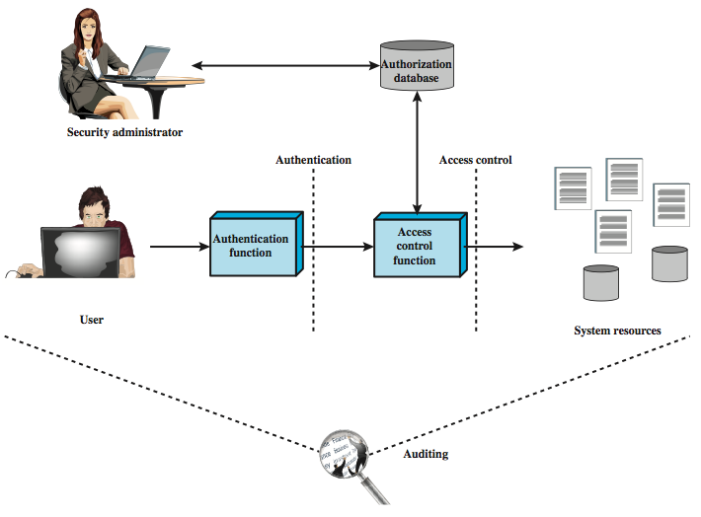
Relationship of access control and other security functions

Slide 43
Access Control
Users and groups
Authentication
Passwords
File protection
• Access control lists
Which users can read/write which files?
Are my files really safe?
What does it mean to be root?
What do we really want to control?

Slide 44
Access Control Matrices
A table that defines permissions.
– Each row of this table is associated with a subject, which is a user, group, or system that can perform actions.
– Each column of the table is associated with an object, which is a file, directory, document, device, resource, or any other entity for which we want to define access rights.
– Each cell of the table is then filled with the access rights for the associated combination of subject and object.
– Access rights can include actions such as reading, writing, copying, executing, deleting, and annotating.
– An empty cell means that no access rights are granted.

Slide 45
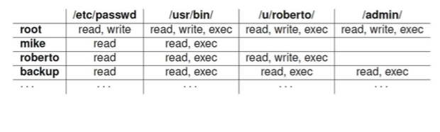
Example Access Control Matrix

Slide 46
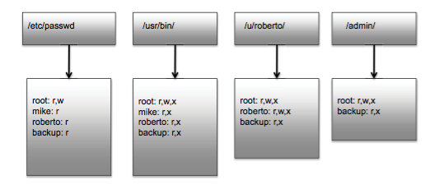
Access Control Lists
It defines, for each object, o, a list, L, called o’s access control list, which enumerates all the subjects that have access rights for o and, for each such subject, s, gives the access rights that s has for object o.

Slide 47
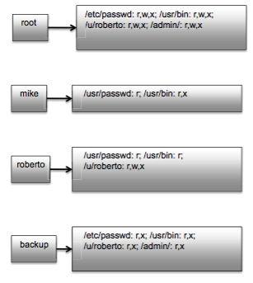
Capabilities
Takes a subject- centered approach to access control. It defines, for each subject s, the list of the objects for which s has nonempty access control rights, together with the specific rights for each such object.

Slide 48
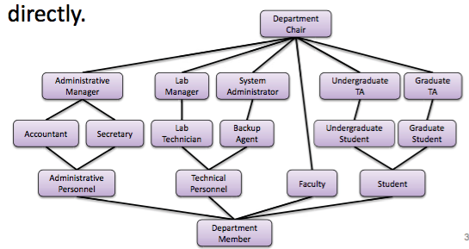
Role-based Access Control
Define roles and then specify access control rights for these roles, rather than for subjects directly.

Slide 49
Constraints - RBAC
Provide a means of adapting RBAC to the specifics of administrative and security policies of an organization
A defined relationship among roles or a condition related to roles
Types:
Mutually exclusive roles
A user can only be assigned to one role in the set (either during a session or statically)
Any permission (access right) can be granted to only one role in the set
Cardinality
Setting a maximum number with respect to roles
Prerequisite roles
Dictates that a user can only be assigned to a particular role if it is already assigned to some other specified role
Notes:
Constraints provide a means of adapting RBAC to the
specifics of administrative and security policies in an organization. A constraint is
a defined relationship among roles or a condition related to roles. [SAND96] lists
the following types of constraints: mutually exclusive roles, cardinality, and prerequisite
roles.
Mutually exclusive roles are roles such that a user can be assigned to only
one role in the set. This limitation could be a static one, or it could be dynamic, in
the sense that a user could be assigned only one of the roles in the set for a session.
The mutually exclusive constraint supports a separation of duties and capabilities
within an organization. This separation can be reinforced or enhanced by use of
mutually exclusive permission assignments. With this additional constraint, a mutually
exclusive set of roles has the following properties:
1. A user can only be assigned to one role in the set (either during a session or
statically).
2. Any permission (access right) can be granted to only one role in the set.
Thus the set of mutually exclusive roles have non-overlapping permissions. If two
users are assigned to different roles in the set, then the users have non-overlapping
permissions while assuming those roles. The purpose of mutually exclusive roles is to
increase the difficulty of collusion among individuals of different skills or divergent job
functions to thwart security policies.
Cardinality refers to setting a maximum number with respect to roles. One
such constraint is to set a maximum number of users that can be assigned to a given
role. For example, a project leader role or a department head role might be limited
to a single user. The system could also impose a constraint on the number of roles
that a user is assigned to, or the number of roles a user can activate for a single session.
Another form of constraint is to set a maximum number of roles that can be
granted a particular permission; this might be a desirable risk mitigation technique
for a sensitive or powerful permission.
A system might be able to specify a prerequisite, which dictates that a user can
only be assigned to a particular role if it is already assigned to some other specified
role. A prerequisite can be used to structure the implementation of the least privilege
concept. In a hierarchy, it might be required that a user can be assigned to a senior
(higher) role only if it is already assigned an immediately junior (lower) role. For
example, in Figure 4.9 a user assigned to a Project Lead role must also be assigned
to the subordinate Production Engineer and Quality Engineer roles. Then, if the user
does not need all of the permissions of the Project Lead role for a given task, the user
can invoke a session using only the required subordinate role. Note that the use of
prerequisites tied to the concept of hierarchy requires the RBAC₃ model.

Slide 50
Attribute-Based Access Control (ABAC)
Can define authorizations that express conditions on properties of both the resource and the subject
Strength is its flexibility and expressive power
Main obstacle to its adoption in real systems has been concern about the performance impact of evaluating predicates on both resource and user properties for each access
Web services have been pioneering technologies through the introduction of the eXtensible Access Control Markup Language (XAMCL)
There is considerable interest in applying the model to cloud services
Notes:
A relatively recent development in access control technology is the attribute-based
access control (ABAC) model. An ABAC model can define authorizations that
express conditions on properties of both the resource and the subject. For example,
consider a configuration in which each resource has an attribute that identifies the
subject that created the resource. Then, a single access rule can specify the ownership
privilege for all the creators of every resource. The strength of the ABAC
approach is its flexibility and expressive power. [PLAT13] points out that the main
obstacle to its adoption in real systems has been concern about the performance
impact
of evaluating predicates on both resource and user properties for each
access. However, for applications such as cooperating Web services and cloud computing,
this increased performance cost is less noticeable because there is already a
relatively high performance cost for each access. Thus, Web services have been pioneering
technologies for implementing ABAC models, especially through the introduction
of the eXtensible Access Control Markup Language (XAMCL) [BEUC13],
and there is considerable interest in applying the ABAC model to cloud services
[IQBA12, YANG12].
There are three key elements to an ABAC model: attributes, which are defined
for entities in a configuration; a policy model, which defines the ABAC policies; and
the architecture model, which applies to policies that enforce access control. We
examine these elements in turn.

Slide 51
ABAC Model: Attributes
Subject attributes
A subject is an active entity that causes information to flow among objects or changes the system state
Object attributes
An object (or resource) is a passive information system-related entity containing or receiving information
Environment attributes
Describe the operational, technical, and even situational environment or context in which the information access occurs
Attributes define the identity and characteristics of the subject
Objects have attributes that can be leverages to make access control decisions
These attributes have so far been largely ignored in most access control policies
Notes:
Attributes are characteristics that define specific aspects of the subject, object, environment
conditions, and/or requested operations that are predefined and preassigned
by an authority. Attributes contain information that indicates the class of information
given by the attribute, a name, and a value (e.g., Class=HospitalRecordsAccess,
Name=PatientInformationAccess, Value=MFBusinessHoursOnly).
The following are the three types of attributes in the ABAC model:
• Subject attributes: A subject is an active entity (e.g., a user, an application, a
process, or a device) that causes information to flow among objects or changes
the system state. Each subject has associated attributes that define the identity
and characteristics of the subject. Such attributes may include the subject’s
identifier, name, organization, job title, and so on. A subject’s role can also be
viewed as an attribute.
• Object attributes: An object, also referred to as a resource , is a passive (in the
context of the given request) information system-related entity (e.g., devices,
files, records, tables, processes, programs, networks, domains) containing or
receiving information. As with subjects, objects have attributes that can be
leveraged to make access control decisions. A Microsoft Word document, for
example, may have attributes such as title, subject, date, and author. Object
attributes can often be extracted from the metadata of the object. In particular,
a variety of Web service metadata attributes may be relevant for access
control purposes, such as ownership, service taxonomy, or even Quality of
Service (QoS) attributes.
• Environment attributes: These attributes have so far been largely ignored in
most access control policies. They describe the operational, technical, and even
situational environment or context in which the information access occurs. For
example, attributes, such as current date and time, the current virus/hacker
activities, and the network’s security level (e.g., Internet vs. intranet), are not
associated with a particular subject nor a resource, but may nonetheless be
relevant in applying an access control policy.

Slide 52
Identity Federation
Term used to describe the technology, standards, policies, and processes that allow an organization to trust digital identities, identity attributes, and credentials created and issued by another organization
Addresses two questions:
How do you trust identities of individuals from external organizations who need access to your systems
How do you vouch for identities of individuals in your organization when they need to collaborate with external organizations
Notes:
Identity federation addresses two questions:
1. How do you trust identities of individuals from external organizations who
need access to your systems?
2. How do you vouch for identities of individuals in your organization when they
need to collaborate with external organizations?
Identity federation is a term used to describe the technology, standards, policies,
and processes that allow an organization to trust digital identities, identity
attributes, and credentials created and issued by another organization. We discuss
identity federation in the following section.

Slide 53
Authentication Process
Fundamental building block and primary line of defense
Basis for access control and user accountability
Identification step
Presenting an identifier to the security system
Verification step
Presenting or generating authentication information that corroborates the binding between the entity and the identifier
Notes:
An authentication process consists of two steps:
Identification step: Presenting an identifier to the security system. (Identifiers
should be assigned carefully, because authenticated identities are the basis for
other security services, such as access control service.)
Verification step: Presenting or generating authentication information that
corroborates the binding between the entity and the identifier.
For example, user Alice Toklas could have the user identifier ABTOKLAS. This
information needs to be stored on any server or computer system that Alice wishes
to use and could be known to system administrators and other users. A typical item
of authentication information associated with this user ID is a password, which is
kept secret (known only to Alice and to the system). If no one is able to obtain or
guess Alice’s password, then the combination of Alice’s user ID and password enables
administrators to set up Alice’s access permissions and audit her activity. Because
Alice’s ID is not secret, system users can send her e-mail, but because her password is
secret, no one can pretend to be Alice.
In essence, identification is the means by which a user provides a claimed identity
to the system; user authentication is the means of establishing the validity of the claim.
Note that user authentication is distinct from message authentication. As defined in
Chapter 2, message authentication is a procedure that allows communicating parties
to verify that the contents of a received message have not been altered and that the
source is authentic. This chapter is concerned solely with user authentication.

Slide 54
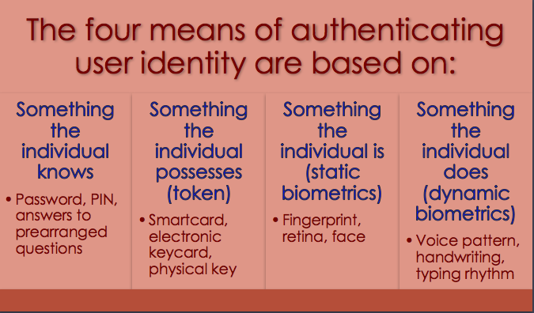
Authentication Process

Slide 55
Password Authentication
Widely used line of defense against intruders
User provides name/login and password
System compares password with the one stored for that specified login
The user ID:
Determines that the user is authorized to access the system
Determines the user’s privileges
Is used in discretionary access control
Notes:
A widely used line of defense against intruders is the password system. Virtually all
multiuser systems, network-based servers, Web-based e-commerce sites, and other
similar services require that a user provide not only a name or identifier (ID) but
also a password. The system compares the password to a previously stored password
for that user ID, maintained in a system password file. The password serves
to authenticate the ID of the individual logging on to the system. In turn, the ID
provides security in the following ways:
• The ID determines whether the user is authorized to gain access to a system.
In some systems, only those who already have an ID filed on the system are
allowed to gain access.
• The ID determines the privileges accorded to the user. A few users may have
supervisory or “superuser” status that enables them to read files and perform
functions that are especially protected by the operating system. Some systems
have guest or anonymous accounts, and users of these accounts have more
limited privileges than others.
The ID is used in what is referred to as discretionary access control. For example,
by listing the IDs of the other users, a user may grant permission to them
to read files owned by that user.

Slide 56
Password Vulnerabilities
Offline dictionary attack
Specific account attack
Popular password attack
Password guessing against single user
Workstation hijacking
Exploiting user mistakes
Exploiting multiple password use
Electronic monitoring
Notes:
In this subsection, we outline the main forms of attack against password-based
authentication and briefly outline a countermeasure strategy. The remainder of
Section 3.2 goes into more detail on the key countermeasures.
We can identify the following attack strategies:
• Offline dictionary attack: Typically, strong access controls are used to protect
the system’s password file. However, experience shows that determined
hackers can frequently bypass such controls and gain access to the file. The
attacker obtains the system password file and compares the password hashes
against hashes of commonly used passwords. If a match is found, the attacker
can gain access by that ID/password combination. Countermeasures include
controls to prevent unauthorized access to the password file, intrusion detection
measures to identify a compromise, and rapid reissuance of passwords
should the password file be compromised.
• Specific account attack: The attacker targets a specific account and submits
password guesses until the correct password is discovered. The standard countermeasure
is an account lockout mechanism, which locks out access to the
account after a number of failed login attempts. Typical practice is no more
than five access attempts.
• Popular password attack: A variation of the preceding attack is to use a popular
password and try it against a wide range of user IDs. A user’s tendency
is to choose a password that is easily remembered; this unfortunately makes
the password easy to guess. Countermeasures include policies to inhibit the
selection by users of common passwords and scanning the IP addresses of
authentication requests and client cookies for submission patterns.
• Password guessing against single user: The attacker attempts to gain knowledge
about the account holder and system password policies and uses that
knowledge to guess the password. Countermeasures include training in and
enforcement of password policies that make passwords difficult to guess.
Such policies address the secrecy, minimum length of the password, character
set, prohibition against using well-known user identifiers, and length of time
before the password must be changed.
• Workstation hijacking: The attacker waits until a logged-in workstation is
unattended. The standard countermeasure is automatically logging the workstation
out after a period of inactivity. Intrusion detection schemes can be
used to detect changes in user behavior.
• Exploiting user mistakes: If the system assigns a password, then the user is
more likely to write it down because it is difficult to remember. This situation
creates the potential for an adversary to read the written password. A user
may intentionally share a password, to enable a colleague to share files, for
example. Also, attackers are frequently successful in obtaining passwords by
using social engineering tactics that trick the user or an account manager into
revealing a password. Many computer systems are shipped with preconfigured
passwords for system administrators. Unless these preconfigured passwords
are changed, they are easily guessed. Countermeasures include user training,
intrusion detection, and simpler passwords combined with another authentication
mechanism.
• Exploiting multiple password use. Attacks can also become much more
effective or damaging if different network devices share the same or a similar
password for a given user. Countermeasures include a policy that forbids the
same or similar password on particular network devices.
• Electronic monitoring: If a password is communicated across a network to
log on to a remote system, it is vulnerable to eavesdropping. Simple encryption
will not fix this problem, because the encrypted password is, in effect, the
password and can be observed and reused by an adversary.

Slide 57
Password Cracking
Dictionary attacks
Develop a large dictionary of possible passwords and try each against the password file
Each password must be hashed using each salt value and then compared to stored hash values
Rainbow table attacks
Pre-compute tables of hash values for all salts
A mammoth table of hash values
Can be countered by using a sufficiently large salt value and a sufficiently large hash length
Password crackers exploit the fact that people choose easily guessable passwords
Shorter password lengths are also easier to crack
John the Ripper
Open-source password cracker first developed in in 1996
Uses a combination of brute-force and dictionary techniques
Notes:
The traditional approach to password guessing,
or password cracking as it is called, is to develop a large dictionary of possible
passwords and to try each of these against the password file. This means that
each password must be hashed using each salt value in the password file and then
compared to stored hash values. If no match is found, then the cracking program
tries variations on all the words in its dictionary of likely passwords. Such variations
include backward spelling of words, additional numbers or special characters, or
sequence of characters,
An alternative is to trade off space for time by precomputing potential hash
values. In this approach the attacker generates a large dictionary of possible passwords.
For each password, the attacker generates the hash values associated with
each possible salt value. The result is a mammoth table of hash values known as a
rainbow table. For example, [OECH03] showed that using 1.4 GB of data, he could
crack 99.9% of all alphanumeric Windows password hashes in 13.8 seconds. This
approach can be countered by using a sufficiently large salt value and a sufficiently
large hash length. Both the FreeBSD and OpenBSD approaches should be secure
from this attack for the foreseeable future.
To counter the use of large salt values and hash lengths, password crackers
exploit the fact that some people choose easily guessable passwords. Some users,
when permitted to choose their own password, pick one that is absurdly short.
One study at Purdue University [SPAF92a] observed password change choices on
54 machines, representing approximately 7000 user accounts. Almost 3% of the
passwords were three characters or fewer in length. An attacker could begin the
attack by exhaustively testing all possible passwords of length 3 or fewer. A simple
remedy is for the system to reject any password choice of fewer than, say, six characters
or even to require that all passwords be exactly eight characters in length. Most
users would not complain about such a restriction.
Password length is only part of the problem. Many people, when permitted
to choose their own password, pick a password that is guessable, such as their
own name, their street name, a common dictionary word, and so forth. This makes
the job of password cracking straightforward. The cracker simply has to test the
password file against lists of likely passwords. Because many people use guessable
passwords, such a strategy should succeed on virtually all systems.
Attacks that use a combination of brute-force and dictionary techniques have
become common. A notable example of this dual approach is John the Ripper, an
open-source password cracker first developed in 1996 and still in use [OPEN13].

Slide 58
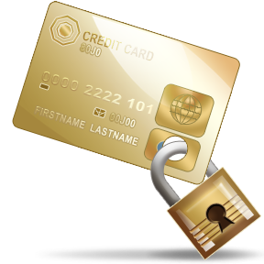
Smart Cards
Most important category of smart token
Has the appearance of a credit card
Has an electronic interface
May use any of the smart token protocols
Contain:
An entire microprocessor
Processor
Memory
I/O ports
Typically include three types of memory:
Read-only memory (ROM)
Stores data that does not change during the card’s life
Electrically erasable programmable ROM (EEPROM)
Holds application data and programs
Random access memory (RAM)
Holds temporary data generated when applications are executed
Notes:
For user authentication the most important category of smart token is the
smart card, which has the appearance of a credit card, has an electronic interface,
and may use any of the type of protocols just described. The remainder of this
section discusses smart cards.
A smart card contains within it an entire microprocessor, including processor,
memory, and I/O ports. Some versions incorporate a special co-processing circuit for
cryptographic operation to speed the task of encoding and decoding messages or generating
digital signatures to validate the information transferred. In some cards, the
I/O ports are directly accessible by a compatible reader by means of exposed
electrical contacts. Other cards rely instead on an embedded antenna for wireless communication
with the reader.
A typical smart card includes three types of memory. Read-only memory
(ROM) stores data that does not change during the card’s life, such as the card
number and the cardholder’s name. Electrically erasable programmable ROM
(EEPROM) holds application data and programs, such as the protocols that the
card can execute. It also holds data that may vary with time. For example, in a
telephone card, the EEPROM holds the talk time remaining. Random access
memory (RAM) holds temporary data generated when applications are executed.

Slide 59
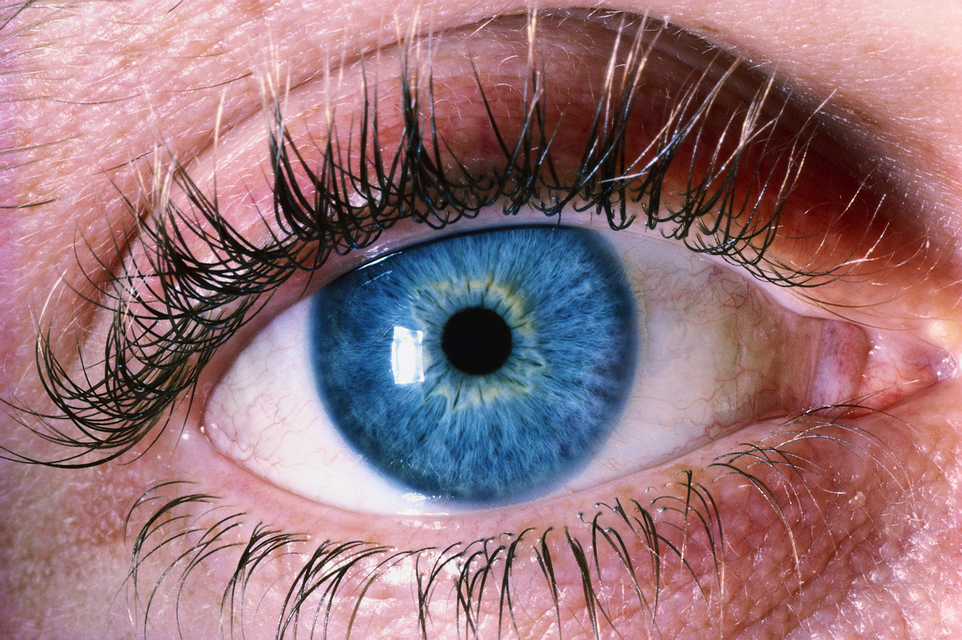
Biometric Authentication
Attempts to authenticate an individual based on unique physical characteristics
Based on pattern recognition
Is technically complex and expensive when compared to passwords and tokens
Physical characteristics used include:
Facial characteristics
Fingerprints
Hand geometry
Retinal pattern
Iris
Signature
Voice
Notes:
A biometric authentication system attempts to authenticate an individual based on
his or her unique physical characteristics. These include static characteristics, such
as fingerprints, hand geometry, facial characteristics, and retinal and iris patterns;
and dynamic characteristics, such as voiceprint and signature. In essence, biometrics
is based on pattern recognition. Compared to passwords and tokens, biometric
authentication is both technically complex and expensive. While it is used in a
number of specific applications, biometrics has yet to mature as a standard tool for
user authentication to computer systems.
A number of different types of physical characteristics are either in use or under
study for user authentication. The most common are the following:
• Facial characteristics: Facial characteristics are the most common means
of human-to-human identification; thus it is natural to consider them for
identification by computer. The most common approach is to define characteristics
based on relative location and shape of key facial features, such as
eyes, eyebrows, nose, lips, and chin shape. An alternative approach is to use an
infrared camera to produce a face thermogram that correlates with the underlying
vascular system in the human face.
• Fingerprints: Fingerprints have been used as a means of identification for
centuries, and the process has been systematized and automated particularly
for law enforcement purposes. A fingerprint is the pattern of ridges and
furrows on the surface of the fingertip. Fingerprints are believed to be unique
across the entire human population. In practice, automated fingerprint recognition
and matching system extract a number of features from the fingerprint
for storage as a numerical surrogate for the full fingerprint pattern.
• Hand geometry: Hand geometry systems identify features of the hand,
including shape, and lengths and widths of fingers.
• Retinal pattern: The pattern formed by veins beneath the retinal surface is
unique and therefore suitable for identification. A retinal biometric system
obtains a digital image of the retinal pattern by projecting a low-intensity
beam of visual or infrared light into the eye.
• Iris: Another unique physical characteristic is the detailed structure of the iris.
• Signature: Each individual has a unique style of handwriting and this is
reflected especially in the signature, which is typically a frequently written
sequence. However, multiple signature samples from a single individual will
not be identical. This complicates the task of developing a computer representation
of the signature that can be matched to future samples.
• Voice: Whereas the signature style of an individual reflects not only the unique
physical attributes of the writer but also the writing habit that has developed,
voice patterns are more closely tied to the physical and anatomical characteristics
of the speaker. Nevertheless, there is still a variation from sample to sample over
time from the same speaker, complicating the biometric recognition task.

Slide 60
Authentication Security Issues
Eavesdropping
Adversary attempts to learn the password by some sort of attack that involves the physical proximity of user and adversary
Host Attacks
Directed at the user file at the host where passwords, token passcodes, or biometric templates are stored
Replay
Adversary repeats a previously captured user response
Client Attacks
Adversary attempts to achieve user authentication without access to the remote host or the intervening communications path
Trojan Horse An application or physical device masquerades as an authentic application or device for the purpose of capturing a user password, passcode, or biometric
Denial-of-Service
Attempts to disable a user authentication service by flooding the service with numerous authentication attempts
Notes:
Client attacks are those in which an adversary attempts to achieve user
authentication without access to the remote host or to the intervening communications
path. The adversary attempts to masquerade as a legitimate user. For a password-
based system, the adversary may attempt to guess the likely user password.
Multiple guesses may be made. At the extreme, the adversary sequences through
all possible passwords in an exhaustive attempt to succeed. One way to thwart such
an attack is to select a password that is both lengthy and unpredictable. In effect,
such a password has large entropy; that is, many bits are required to represent the
password. Another countermeasure is to limit the number of attempts that can be
made in a given time period from a given source.
A token can generate a high-entropy passcode from a low-entropy PIN or password,
thwarting exhaustive searches. The adversary may be able to guess or acquire
the PIN or password but must additionally acquire the physical token to succeed.
Host attacks are directed at the user file at the host where passwords, token
passcodes, or biometric templates are stored. Section 3.2 discusses the security
considerations with respect to passwords. For tokens, there is the additional
defense of using one-time passcodes, so that passcodes are not stored in a host
passcode file. Biometric features of a user are difficult to secure because they are
physical features of the user. For a static feature, biometric device authentication
adds a measure of protection. For a dynamic feature, a challenge-response
protocol enhances security.
Eavesdropping in the context of passwords refers to an adversary’s attempt to
learn the password by observing the user, finding a written copy of the password,
or some similar attack that involves the physical proximity of user and adversary.
Another form of eavesdropping is keystroke logging (keylogging), in which malicious
hardware or software is installed so that the attacker can capture the user’s keystrokes
for later analysis. A system that relies on multiple factors (e.g., password plus token or
password plus biometric) is resistant to this type of attack. For a token, an analogous
threat is theft of the token or physical copying of the token. Again, a multifactor
protocol resists this type of attack better than a pure token protocol. The analogous
threat for a biometric protocol is copying or imitating the biometric
parameter so as to generate the desired template. Dynamic biometrics are less susceptible
to such attacks. For static biometrics, device authentication is a useful countermeasure.
Replay attacks involve an adversary repeating a previously captured
user response. The most common countermeasure to such attacks is the challenge-response
protocol.
In a Trojan horse attack, an application or physical device masquerades as
an authentic application or device for the purpose of capturing a user password,
passcode, or biometric. The adversary can then use the captured information to
masquerade as a legitimate user. A simple example of this is a rogue bank machine
used to capture user ID/password combinations.
A denial-of-service attack attempts to disable a user authentication service by
flooding the service with numerous authentication attempts. A more selective attack
denies service to a specific user by attempting logon until the threshold is reached
that causes lockout to this user because of too many logon attempts. A multifactor
authentication protocol that includes a token thwarts this attack, because the
adversary must first acquire the token.

Slide 61
Chapter 1: roadmap
1.1 Fundamental Concepts
1.2 Access Control Models
1.3 Cryptographic Concepts
1.4 Implementation and Usability Issues

Slide 62
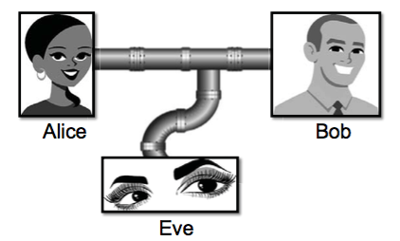
Cryptographic Concepts
Encryption: a means to allow two parties, customarily called Alice and Bob, to establish confidential communication over an insecure channel that is subject to eavesdropping.

Slide 63
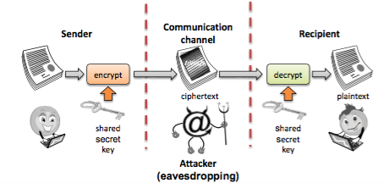
Encryption and Decryption
The message M is called the plaintext.
Alice will convert plaintext M to an encrypted form using an encryption algorithm E that outputs a ciphertext C for M.

Slide 64
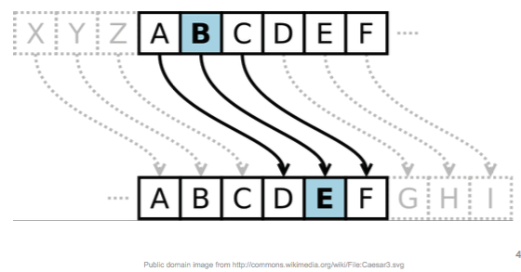
Caesar Cipher
Replace each letter with the one “three over” in the alphabet.

Slide 65
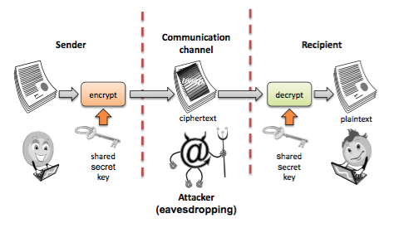
Symmetric Cryptosystems
Alice and Bob share a secret key, which is used for both encryption and decryption.

Slide 66
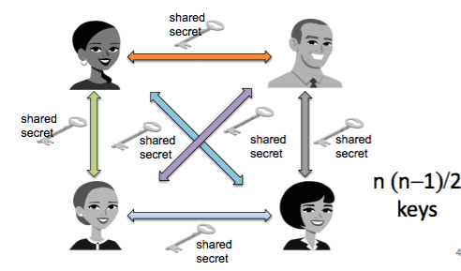
Symmetric Key Distribution
• Requires each pair of communicating parties to share a (separate) secret key.

Slide 67
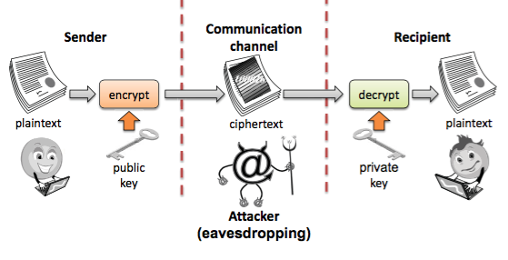
Public-Key Cryptography
• Separate keys are used for encryption and decryption.

Slide 68
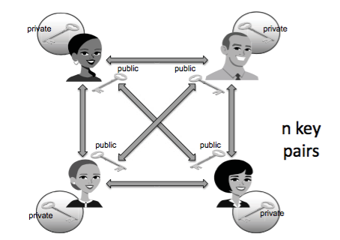
Public-Key Distribution
• Only one key is needed for each recipient

Slide 69
Digital Signatures
Public-key encryption provides a method for doing digital signatures
To sign a message, M, Alice just encrypts it with her private key
Anyone can decrypt this message using Alice’s public key and compare that to the message M.

Slide 70
Cryptographic Hash Functions
A checksum on a message, M, that is:
One-way: it should be easy to compute Y=H(M), but hard to find M given only Y
Collision-resistant: it should be hard to find two messages, M and N, such that H(M)=H(N).
Examples: SHA-1, SHA-256.

Slide 71
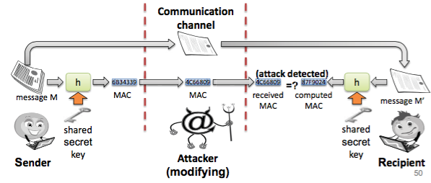
Message Authentication Codes
Allows for Alice and Bob to have data integrity, if they share a secret key.
Given a message M, Alice computes H(K||M) and sends M and this hash to Bob.

Slide 72
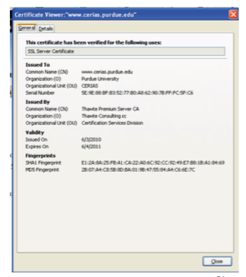
Digital Certificates
certificate authority (CA) digitally signs a binding between an identity and the public key for that identity.

Slide 73
Chapter 1: roadmap
1.1 Fundamental Concepts
1.2 Access Control Models
1.3 Cryptographic Concepts
1.4 Implementation and Usability Issues

Slide 74
Passwords
A short sequence of characters used as a means to authenticate someone via a secret that they know.
Userid: _________________
Password: ______________

Slide 75
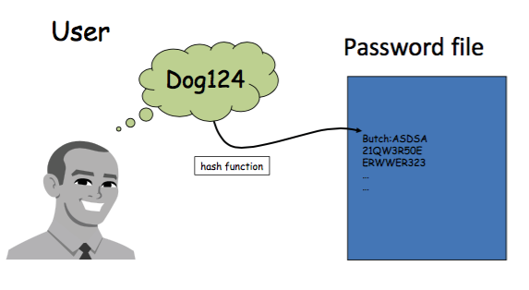
How a password is stored?

Slide 76
Strong Passwords
What is a strong password – UPPER/lower case characters – Special characters – Numbers
When is a password strong?
– Seattle1
– M1ke03 – P@$$w0rd – TD2k5secV

Slide 77
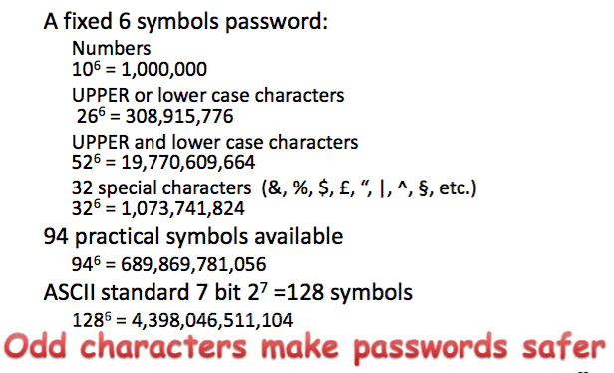
Password Complexity

Slide 78
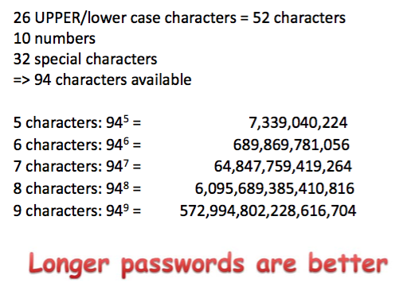
Password length

Slide 79
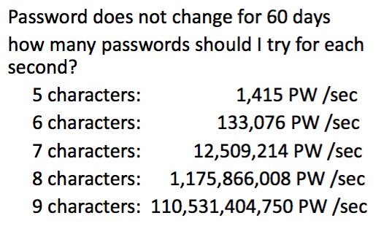
Password Validity: Brute Force Test

Slide 80
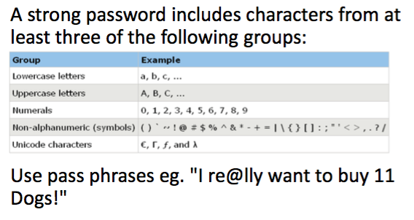
Secure Passwords

Slide 81
Social Engineering
• Pretexting: creating a story that convinces an administrator or operator into revealing secret information.
• Baiting: offering a kind of “gift” to get a user or agent to perform an insecure action.
• Quid pro quo: offering an action or service and then expecting something in return.

Slide 82

Questions
(Source: bestclipartblog.com)

